Slide 1

A Final year project Proposal on
Travel Feed For Kathmandu Valley
Manoj Acharya (7982/072)
Pankaj Bhattarai (7985/072)
Prabash Paudel (7986/072)
Pramod Khatiwada (7988/072)
Presented By:
Under the supervision of
Sandeep Aryal

Slide 2
TABLE OF CONTENTS
Introduction
Problem Statement
Objective
Scope & Limitations
Feasibility Study
Analysis and Design
Algorithm Used
Implementation Tools

Slide 3
INTRODUCTION
A Travel Experiencing Sharing Platform for Kathmandu Valley.
Uses a K Means Clustering Algorithm (to make same user group).
A Recommendation Platform.
1

Slide 4


PROBLEM DEFINATION
Where to go?
2

Slide 5
OBJECTIVES
To create profile of travel destination to reduce variation in information.
To connect fellow travelers.
To recommend travel destinations of inside valley.
To promote unnoticed travel destinations.
3

Slide 6
SCOPE & LIMITATIONS
1Mn+ of google searches every year about travel in Nepal.
Every year NTB announce new travel destinations.
1Mn+ of google searches every year about travel in Nepal.
Every year NTB announce new travel destinations.
4

Slide 7
SCOPE & LIMITATIONS
1Mn+ of google searches every year about travel in Nepal.
Every year NTB announce new travel destinations.
1Mn+ of google searches every year about travel in Nepal.
Every year NTB announce new travel destinations.
Admin needs to approve newly created destination profile.
Other users can’t have access to edit the destination profile content.
Admin needs to approve newly created destination profile.
Other users can’t have access to edit the destination profile content.
4

Slide 8
FEASIBILITY ANALYSIS
Economic Feasibility
System launch can be inexpensive.
Maintenance & Upgrade is low-cost.
Global accessible in low budget.
Cheap cost to implement
Not for commercial
5

Slide 9
FEASIBILITY ANALYSIS
Economic Feasibility
Operational Feasibility
System launch can be inexpensive.
Maintenance & Upgrade is low-cost.
Global accessible in low budget.
Easy to Navigate.
Responsive Design
Independent Screen size.
Cheap cost to implement
Not for commercial
Lower System Requirement
No premium stuffs to develop
5

Slide 10
FEASIBILITY ANALYSIS
Economic Feasibility
Operational Feasibility
Technical Feasibility
Light-Weight.
Operating System independent.
Optimized space
System launch can be inexpensive.
Maintenance & Upgrade is low-cost.
Global accessible in low budget.
Easy to Navigate.
Responsive Design
Independent Screen size.
Cheap cost to implement
Not for commercial
Lower System Requirement
No premium stuffs to develop
Used Technologies are Open Source
Community based Package used
5

Slide 11
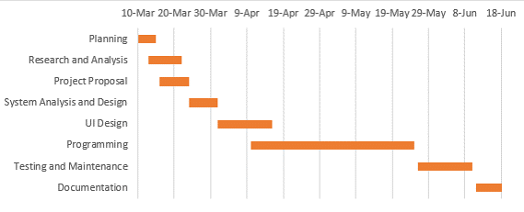
FEASIBILITY ANALYSIS
Timing Diagram
6

Slide 12
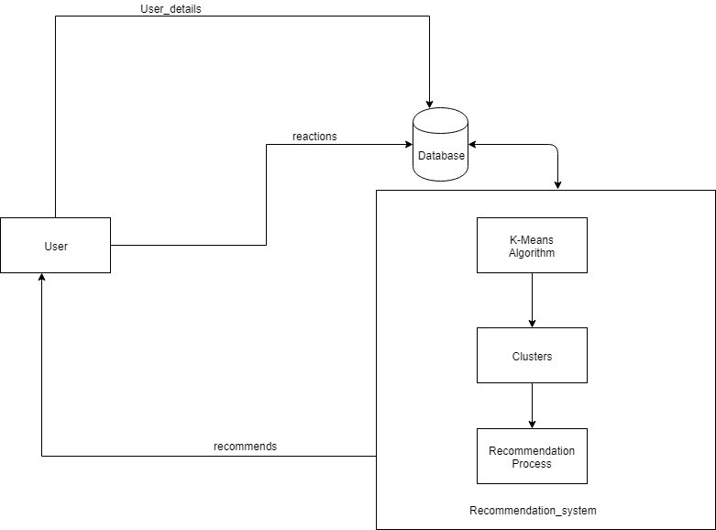
PROPOSED WORK
7

Slide 13
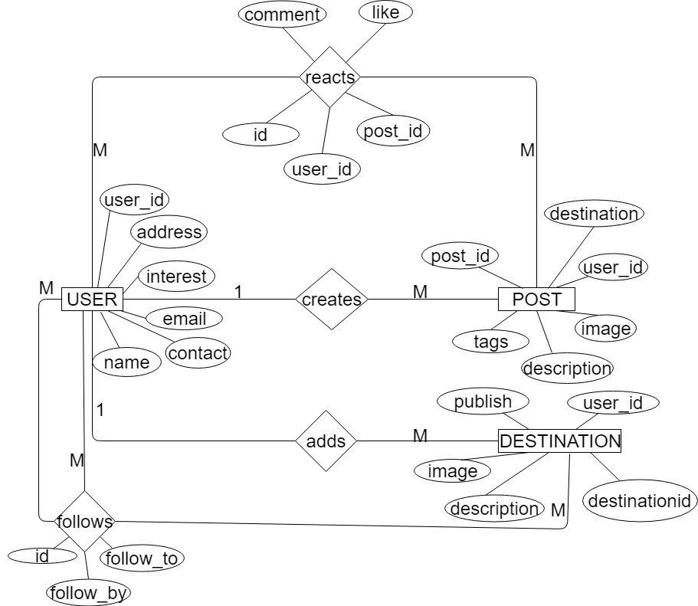
ER-DIAGRAM
8

Slide 14
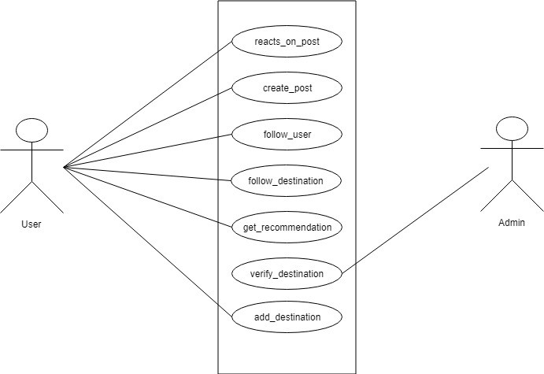
REQUIREMENT ANALYSIS
Functional Requirement
9

Slide 15
REQUIREMENT ANALYSIS
Non-Functional Requirement
Responsiveness & Page Speed.
Optimized Performance.
Interactive Design.
10

Slide 16
ALGORITHM
K-Means Algorithm
If K is given, the K-means algorithm can be executed in the following steps:
STEP-1: Partition of objects into k non-empty subsets
STEP-2: Identifying the cluster centroids (mean point) of the current partition.
STEP-3: Assigning each point to a specific cluster
STEP-4: Compute the distances from each point and allot points to the cluster where the distance from the centroid is minimum.
STEP-5: After re-allotting the points, find the centroid of the new cluster formed.
11

Slide 17
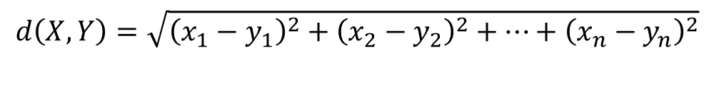
ALGORITHM
K-Means Algorithm
Formula Used To Calculate Distance between Centroid And Data Point ;
$$ⅆ\left(X,Y\right)=\sqrt{{\left(x_{1}−y_{1}\right)}^{2}+{\left(x_{2}−y_{2}\right)}^{2}+…+{\left(x_{n}−y_{n}\right)}^{2}}$$
where,
d(x,y) is the distance between the data point and centroid,
(x_{1,}x_{2,….}x_{n}) is the data sets or data points,
(y_{1,}y_{2,…..}yn) is the centroids,
n is the no of data points which is same as the no of clusters (K).
12

Slide 18
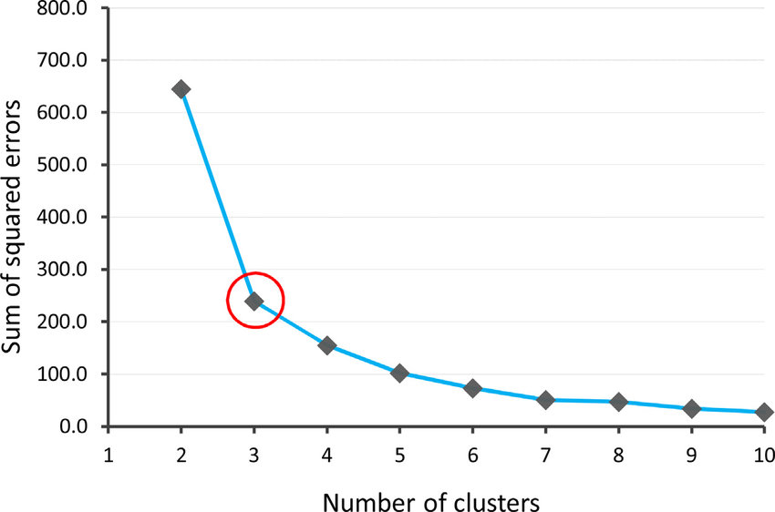
ALGORITHM
Finding value of K
13

Slide 19
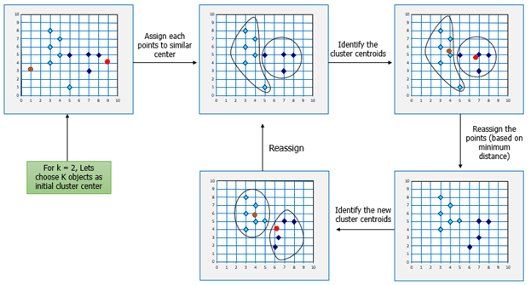
ALGORITHM
K-Means Algorithm
14

Slide 20
IMPLEMENTATION & TOOLS
Implementation
HTML, CSS, Bootstrap, JavaScript
PHP, Laravel Framework, MySQL
K-Means, Collaborative Filtering
HTML, CSS, Bootstrap, JavaScript
PHP, Laravel Framework, MySQL
K-Means, Collaborative Filtering
15

Slide 21
IMPLEMENTATION & TOOLS
Implementation
Tools
HTML, CSS, Bootstrap, JavaScript
PHP, Laravel Framework, MySQL
K-Means, Collaborative Filtering
VS Code
GitHub
Draw.io
HTML, CSS, Bootstrap, JavaScript
PHP, Laravel Framework, MySQL
K-Means, Collaborative Filtering
VS Code
GitHub
Draw.io
15

Slide 22
Thank You!

